Slide 1


An alternative passenger transport model for SATIM
Théophile CROUZET 21/08/2019

Slide 2

Cover of TIME , May 13, 2019
Photographer : Johnny Miller
Notes:
Sure that you saw it, when I started my internship
not discuss about how bad it is or denounce someone
Illustrate perfectly how heterogenous the population is
= different consumption (energy) , access to facilities, activities, and so different mode of travel , behaviour and travel habits.
How measure it ?

Slide 3
Introduction : SATIM
Energy demand
Economic constraints
Technological constraints
Energy supply least-cost solution
Transport
Industry
Agriculture
Commercial
Residential
Demand sectors
Supply sectors
Electricity
Liquid fuel
Notes:
-powerful model which allows to generate energy systems and dynamics over a chosen time horizon
-relies on a demand-supply methodology. It takes into account economic constraints and technological constraints as fuel price, policies, new technologies, potential investment to compute an energy supply least-cost solution
-It has five demand sectors and two supply sectors

Slide 4
Introduction : SATIM
Household income
GDP
SATIM
CGE model
Expenditure on expansion plan
Production and consumption functions
Notes:
- Link model to provide long-term projection reducing uncertainties and to have economic feedback → exogenous demand , particularly for the transport because exogenous population projection

Slide 5
Passenger demand calculation
Travel Time budget
Car ownership
Travel demand
Travel Speed
Car occupancy
Total population

Slide 6
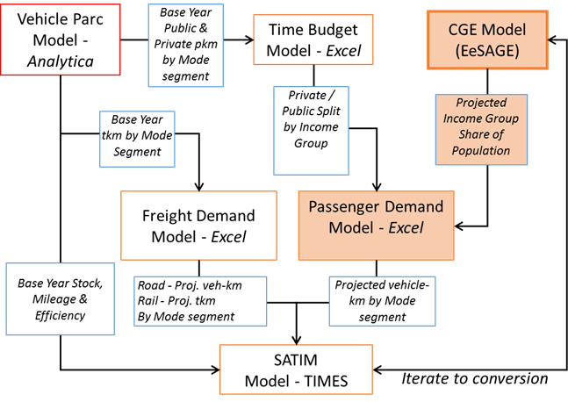
Transport demand sub-models
Vehicle parc model
Notes:
In order to calculate the transport demand, the SATIM relies on different exogenous sub-models. We will focus on the passenger demand and not on the freight demand. The two sub-models I worked on are the time budget model and the passenger demand model.

Slide 7
Time budget model calibration
Access to vehicle
Private and public speeds
Checks
Travel time budget split
Total vehicles
Time budget model
Calibrated parameters
Vehicle parc model
Total private and public pkm
Assumptions
Travel time
Vehicle occupancy
Total vehicle-km
Vehicle mileage by income group

Slide 8
Passenger demand model
Access to vehicle
Private and public speeds
Travel time budget split
Travel time
Vehicle occupancy
Vehicle mileage by income group
Time budget model
Passenger demand model
Projected vehicle-km and pkm by mode segment
CGE model
Populations projections by income group

Slide 9
NHTS 2013 data update calibration
Travel time budget
Travel days
Vehicle occupancy
Access to vehicle
Private and public speeds
Travel time budget split
Update the parameters
Remove the assumptions

Slide 10
NHTS 2013 data update calibration
Travel time budget
Travel days
Vehicle occupancy
Access to vehicle
Private and public speeds
Travel time budget split
Income group | Low | Middle | High
old TTB (hours) | 1.10 | 1.10 | 1.10
New TTB (hours) | 1.32 | 1.35 | 1.39
Notes:
TTB = number of hours people are likely to travel in a day
International studies = stable, constant for all the world population
but at a disaggregated level no longer valid. Richest people can afford different activities. It’s not about speed because according to the studies … but it is about money !
confirmed by NHTS values
- People travel more, or longer : because of low density cities ?

Slide 11
NHTS 2013 data update calibration
Travel days
Vehicle occupancy
Access to vehicle
Private and public speeds
Travel time budget split
Income group | low | Middle | High
Old values (days) | 300 | 300 | 300
New values (days) | 201 | 232 | 284
Notes:
Same phenomenon + low income more likely to be unemployed .

Slide 12
NHTS 2013 data update calibration
Vehicle occupancy
Access to vehicle
Private and public speeds
Travel time budget split
Income group | low | Middle | High | RSA
Old values (per/car) | 1.4 | 1.4 | 1.4 | 1.4
New values (per/car) | 3.21 | 2.30 | 1.47 | 1.68
Data from Roux et al. 2002 (Cape Town)
Average car occupancy (per/car) | 1.83
Notes:
-full assumption , quite different from the South African studies.

Slide 13
NHTS 2013 data update calibration
Access to vehicle
Private and public speeds
Travel time budget split
Income group | low | Middle | High
Old values (% of population) | 2% | 53% | 78%
New values (% of population) | 12% | 27% | 78%

Slide 14
NHTS 2013 data update calibration
Private and public speeds
Travel time budget split
Old public speed (km/hours) | 21.7
New public speed (km/hours) | 24.5
Old private speed (km/hours) | 33.2
new private speed (km/hours) | 39
Data from Hitge et al. 2015 (Cape Town)
private speed (km/hours) | 38.4
public speed (km/hours) | 27.4

Slide 15
NHTS 2013 data update calibration
Travel time budget split
Income group | low | Middle | High
Old values (% trips using private mode) | 25% | 52% | 80%
New values (% trips using private mode) | 46% | 74% | 84%

Slide 16
Data update results

Slide 17
Data update results

Slide 18
Data update results

Slide 19
Current population subdivision
Total population
Low income group
Access to car
No access to car
Medium Income group
Access to car
High income group
No access to car
Access to car
No access to car

Slide 20
Why disaggregate the demand ?
Geographical location | Population (millions of persons) | Private vehicle mileage ('000km/year/veh) | Private vehicles total (millions of vehicles)
Rural | 19.48 | 10.89 | 0.77
Urban | 33.55 | 14.35 | 5.27

Slide 21
Why disaggregate the demand ?

Slide 22
Why disaggregate the demand ?

Slide 23
Why disaggregate the demand ?

Slide 24
Disaggregation
Western Cape
Eastern Cape
Northern Cape
Income quintile 1
Rural area
Free State
Income quintile 2
Access to car
Total population
Urban area
KwaZulu-Natal
Income quintile 3
No access to car
North West
Income quintile 4
Income quintile 5
Gauteng
Mpumalanga
Limpopo

Slide 25
New population projections
Population distribution for the year y-1
CGE model
Growth rates per quintiles and per geographical location
World
Bank data
Total population by income group
Total population by geo. location
Population distribution for the year y

Slide 26
New population projection

Slide 27
Base year calibration comparison

Slide 28
Total vehicle parc projection
Notes:
Add reference case

Slide 29
Total vehicle parc projection
Notes:
Mention numbers

Slide 30
Passenger-km demand

Slide 31
Fuel consumption

Slide 32
Thank you for listening ! Any questions ?

